Slide 1

Department of CSE
Course: AI & ML
Course code: 24AD2001A
Topic:
cluster validity metrics, Dimensionality Reduction: PCA, LDA
Session – 33

Slide 2
cluster validity metrics
Cluster validity metrics quantitatively evaluate the quality and coherence of clusters, using internal measures (like Silhouette Score, Dunn Index) that rely on cluster characteristics, or external measures (like Purity, Adjusted Rand Index) that compare clusters to known ground-truth labels. These metrics help determine the optimal number of clusters, assess algorithm performance, and compare different clustering methods by measuring cluster compactness and separation.

Slide 3
Why Use Cluster Validity Metrics?
Evaluate Cluster Quality: To determine if the clusters formed are meaningful, coherent, and useful.
Determine the Optimal Number of Clusters: To select the most appropriate number of clusters for a given dataset.
Compare Clustering Algorithms: To compare the performance of different clustering algorithms or different configurations (hyperparameters).
Validate Results: To ensure that the patterns identified by the algorithm are not due to random chance but represent actual structures in the data

Slide 4
Categories of Cluster Validity Metrics
Cluster validity metrics are broadly divided into two main categories:
Internal Metrics (Intrinsic Evaluation): These metrics assess cluster quality based on the inherent properties of the data and cluster assignments, without requiring any external information or ground truth labels.
Purpose: To measure the cohesion (how similar data points within a cluster are) and separation (how different clusters are from each other).
Examples:
  Silhouette Score: Measures how similar an object is to its own cluster compared to other clusters.
  Dunn Index: Compares the distances between clusters to find the minimum inter-cluster distance and the maximum intra-cluster distance.
  Connectivity: Assesses how well data points are placed in clusters as their nearest neighbors.
  Within-Cluster Sum of Squares (WCSS): Measures the total variance within each cluster; lower values indicate better clusters

Slide 5
Let us take a look at Silhouette Score clustering metrics:
1. Silhouette Score
The Silhouette Score is a way to measure how good the clusters are in a dataset. It helps us understand how well the data points have been grouped. The score ranges from -1 to 1.
A score close to 1 means a point fits really well in its group (cluster) and is far from other groups.
A score close to 0 means the point is on the border between two clusters.
A score close to -1 means the point might be in the wrong cluster.
Silhouette Score (S) for a data point i is calculated as:

Slide 6
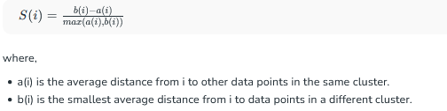

Slide 7
External Metrics (Extrinsic Evaluation):
These metrics use pre-defined ground truth labels to compare the clustering results with a known correct structure.
Purpose: To evaluate how well the identified clusters align with the actual classes in the data.
Examples:
  Purity: Measures the extent to which clusters contain data points from a single class.
  Precision & Recall: Assess the accuracy of cluster assignments by measuring the proportion of correctly predicted instances.
  Adjusted Rand Index: A common metric that measures the similarity between two data clusterings, accounting for chance.
  Normalized Mutual Information: Measures the mutual information between two clusterings, normalized by the entropy of each clustering

Slide 8
EX: Adjusted Rand Index (ARI) METRIC EVALUATION
The Adjusted Rand Index (ARI) helps us measure how accurate a clustering result is by comparing it to the true labels (ground truth).
It checks how well the pairs of points are grouped:
Are the same pairs together in both the real and predicted clusters?
Are different pairs also kept apart correctly?
The score ranges from -1 to 1:
1 means perfect match - the clustering is exactly right.
0 means random guess - no better than chance.
Below 0 means worse than random - very poor clustering.
Adjusted Rand Index (ARI) is calculated as:

Slide 9
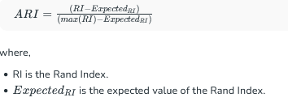

Slide 10
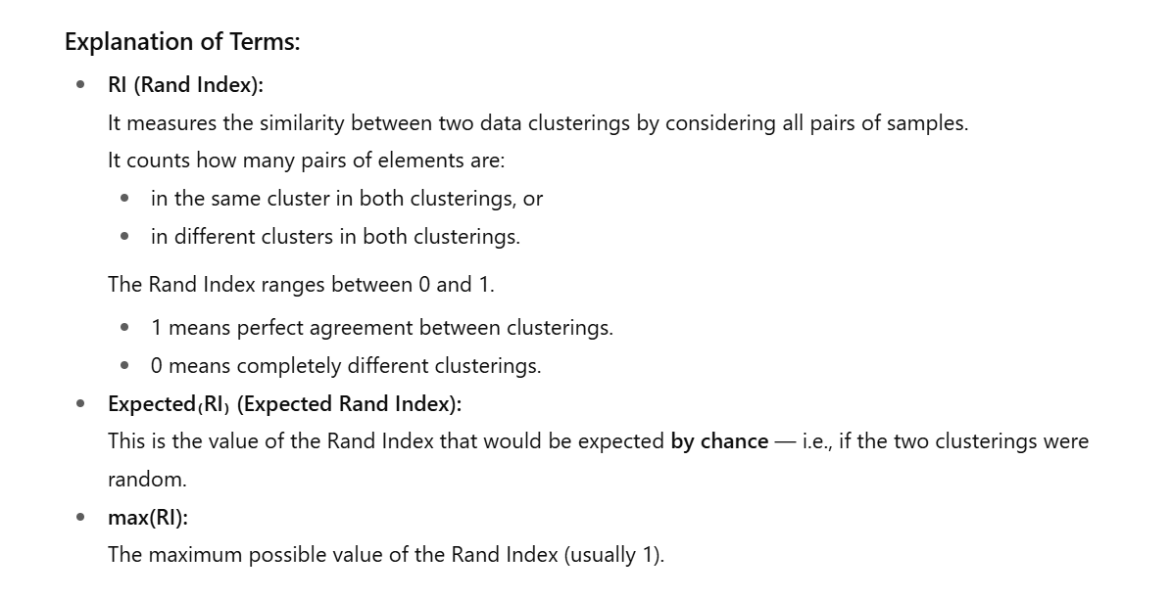

Slide 11
Mutual Information (MI)
Mutual Information measures how much two variables are related or connected. In clustering, it compares how much the true cluster labels match with the predicted labels. It shows how much knowing about one variable helps us predict the other. The more agreement there is, the higher the score.
Higher values mean better agreement between the clusters.
Zero means no agreement at all. MI between true labels Y and predicted labels Z is calculated as:

Slide 12
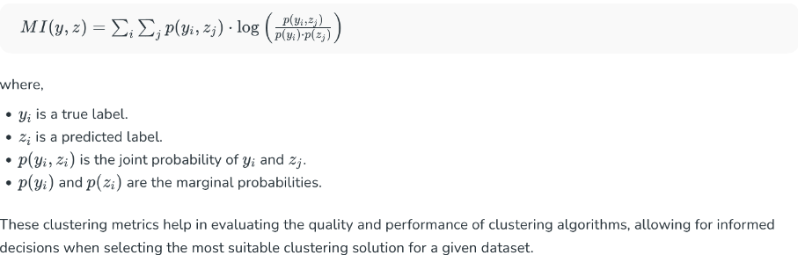
CONTD..

Slide 13
Dimensionality Reduction
When working with machine learning models, datasets with too many features can cause issues like slow computation and overfitting. Dimensionality reduction helps to reduce the number of features while retaining key information. It converts high-dimensional data into a lower-dimensional space while preserving important details. Dimensionality reduction technique can be defined as, "It is a way of converting the higher dimensions dataset into lesser dimensions dataset ensuring that it provides similar information.“
By reducing the dimensions of the features, the space required to store the dataset also gets reduced.
• Less Computation training time is required for reduced dimensions of features.
• Reduced dimensions of features of the dataset help in visualizing the data quickly.
• It removes the redundant features (if present).

Slide 14
Two ways of Dimensionality Reduction
1. Feature Selection
2. Feature Extraction
1. Feature Selection: Feature selection is the process of selecting the subset of the relevant features and leaving out the irrelevant features present in a dataset to build a model of high accuracy. In other words, it is a way of selecting the optimal features from the input dataset.

Slide 15
Feature Selection – 3 Methods
• 1.Filter Method
• Correlation
• Chi-Square Test
• ANOVA
• Information Gain, etc.
• 2.Wrapper Method
• Forward Selection
• Backward Selection
• Bi-directional Elimination
• 3.Embedded Method
• LASSO
• Elastic Net
• Ridge Regression, etc.

Slide 16
CONTD..
2. Feature Extraction: Feature extraction is the process of transforming the space ontaining many dimensions into space with fewer dimensions.
• This approach is useful when we want to keep the whole information but use fewer resources while processing the information
Some common feature extraction techniques are:
1.Principal Component Analysis (PCA)
2.Linear Discriminant Analysis (LDA)
3.Kernel PCA
4.Quadratic Discriminant Analysis (QDA)etc.

Slide 17
Dimensionality Reduction: PCA
PCA (Principal Component Analysis) is a dimensionality reduction technique used in data analysis and machine learning. It helps you to reduce the number of features in a dataset while keeping the most important information. It changes your original features into new features these new features don’t overlap with each other and the first few keep most of the important differences found in the original data.
PCA is commonly used for data preprocessing for use with machine learning algorithms. It helps to remove redundancy, improve computational efficiency and make data easier to visualize and analyze especially when dealing with high-dimensional data.
It transforms a data set into a set of orthogonal components — called principal components — which capture the maximum variance in the data. PCA simplifies complex data sets while preserving their most important structures.

Slide 18
What Are Principal Components?
Principal components are new variables that are constructed as linear combinations or mixtures of the initial variables. These combinations are done in such a way that the new variables (i.e., principal components) are uncorrelated and most of the information within the initial variables is squeezed or compressed into the first components. So, the idea is 10-dimensional data gives you 10 principal components, but PCA tries to put maximum possible information in the first component, then maximum remaining information in the second and so on, until having something like shown in the screen plot below.
principal components represent the directions of the data that explain a maximal amount of variance, that is to say, the lines that capture most information of the data. The relationship between variance and information here, is that, the larger the variance carried by a line, the larger the dispersion of the data points along it, and the larger the dispersion along a line, the more information it has.

Slide 19
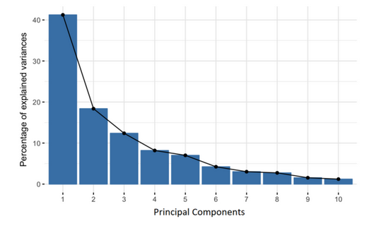
CONTD..

Slide 20
How Principal Component Analysis Works: 5 Steps
The aim of this step is to standardize the range of the continuous initial variables so that each one of them contributes equally to the analysis.
More specifically, the reason why it is critical to perform standardization prior to PCA, if there are large differences between the ranges of initial variables, those variables with larger ranges will dominate over those with small ranges (for example, a variable that ranges between 0 and 100 will dominate over a variable that ranges between 0 and 1), which will lead to biased results. So, transforming the data to comparable scales can prevent this problem.
Mathematically, this can be done by subtracting the mean and dividing by the standard deviation for each value of each variable.

Slide 21


Slide 22
CONTD..
Step 2: Covariance Matrix Computation
The aim of this step is to understand how the variables of the input data set are varying from the mean with respect to each other. Because sometimes, variables are highly correlated in such a way that they contain redundant information. So, in order to identify these correlations, we compute the covariance matrix.
Please note that the covariance matrix contains -
1. variance of dimensions as the main diagonal elements
2. covariance of dimensions as the off-diagonal elements

Slide 23


Slide 24
CONTD..
Variance serves as a metric for the variability, essentially quantifying the extent to which the dataset is dispersed. In mathematical terms, it represents the average squared deviation from the mean score. The formula employed to calculate variance, denoted as var(x), is expressed as follows.
Covariance quantifies the degree to which corresponding elements in two sets of ordered data exhibit similar directional movement. In this context, xi represents the value of x in the ith dimension, while the x bar and y bar denote their respective mean values. Now, let’s explore this concept in matrix format. If we have a matrix X with dimensions m*n, containing n data points each with m dimensions, the covariance matrix can be computed as follows:

Slide 25


Slide 26
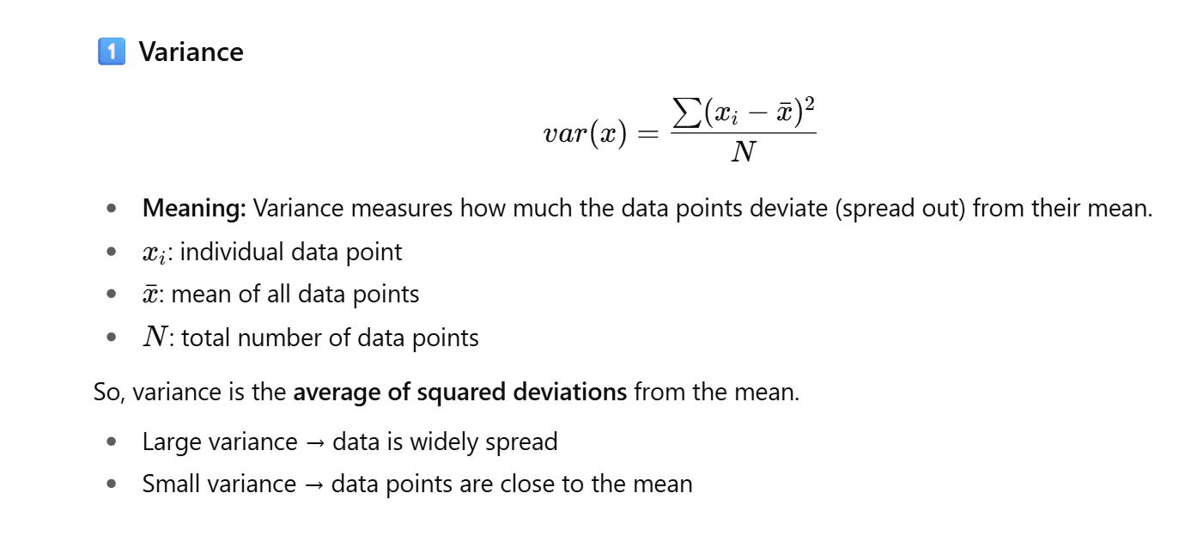

Slide 27
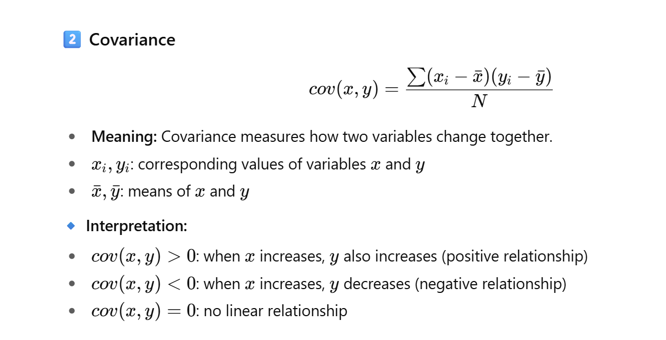

Slide 28
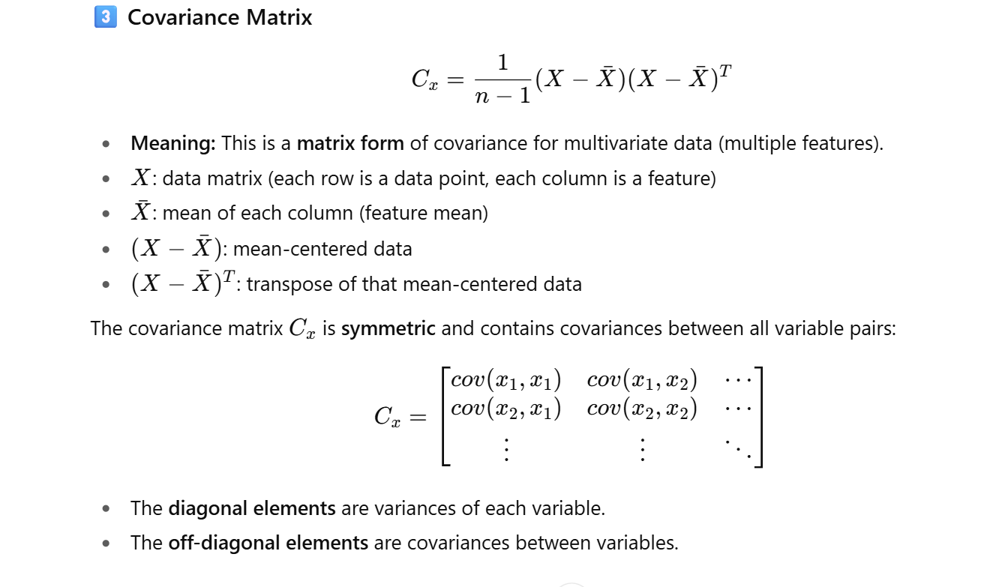

Slide 29
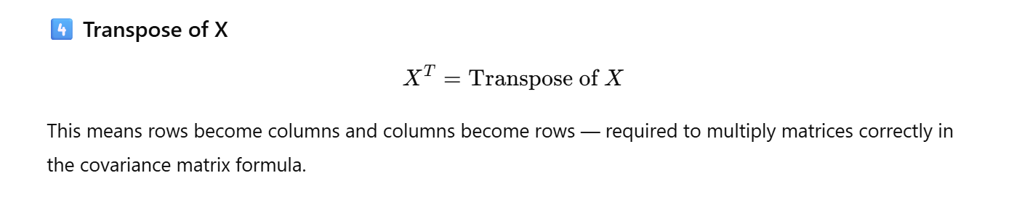

Slide 30
Since the covariance of a variable with itself is its variance (Cov(a,a)=Var(a)), in the main diagonal (Top left to bottom right) we actually have the variances of each initial variable. And since the covariance is commutative (Cov(a,b)=Cov(b,a)), the entries of the covariance matrix are symmetric with respect to the main diagonal, which means that the upper and the lower triangular portions are equal.
What do the covariances that we have as entries of the matrix tell us about the correlations between the variables?
It’s actually the sign of the covariance that matters:
If positive then: the two variables increase or decrease together (correlated)
If negative then: one increases when the other decreases (Inversely correlated)
Now that we know that the covariance matrix is not more than a table that summarizes the correlations between all the possible pairs of variables

Slide 31
CONTD..
covariance matrix exhibits the following characteristics:
1. Significant values as the main diagonal elements.
2. Zero values as the off-diagonal elements.
Hence, the original data points must be transformed to achieve a covariance matrix resembling a diagonal matrix. This process of transforming a matrix into a diagonal matrix is referred to as diagonalization, and it constitutes the primary motivation behind Principal Component Analysis (PCA).

Slide 32
Step 3: Eigen Decomposition and Identifying Principal Components
Eigenvectors and eigenvalues are the linear algebra concepts that we need to compute from the covariance matrix in order to determine the principal components of the data.
What you first need to know about eigenvectors and eigenvalues is that they always come in pairs, so that every eigenvector has an eigenvalue. Also, their number is equal to the number of dimensions of the data. For example, for a 3-dimensional data set, there are 3 variables, therefore there are 3 eigenvectors with 3 corresponding eigenvalues.
It is eigenvectors and eigenvalues who are behind all the magic of principal components because the eigenvectors of the Covariance matrix are actually the directions of the axes where there is the most variance (most information) and that we call Principal Components. And eigenvalues are simply the coefficients attached to eigenvectors, which give the amount of variance carried in each Principal Component.
By ranking your eigenvectors in order of their eigenvalues, highest to lowest, you get the principal components in order of significance.

Slide 33
CONTD..
Step 4: Feature Selection and Creating a Feature Vector
As we saw in the previous step, computing the eigenvectors and ordering them by their eigenvalues in descending order, allow us to find the principal components in order of significance. In this step, what we do is, to choose whether to keep all these components or discard those of lesser significance (of low eigenvalues), and form with the remaining ones a matrix of vectors that we call Feature vector.
So, the feature vector is simply a matrix that has as columns the eigenvectors of the components that we decide to keep. This makes it the first step towards dimensionality reduction, because if we choose to keep only p eigenvectors (components) out of n, the final data set will have only p dimensions.

Slide 34
CONTD..
Step 5: Data Projection
In the previous steps, apart from standardization, you do not make any changes on the data, you just select the principal components and form the feature vector, but the input data set remains always in terms of the original axes (i.e., in terms of the initial variables).
In this step, which is the last one, the aim is to use the feature vector formed using the eigenvectors of the covariance matrix, to reorient the data from the original axes to the ones represented by the principal components (hence the name Principal Components Analysis). This can be done by multiplying the transpose of the original data set by the transpose of the feature vector.

Slide 35
Here’s how PCA works:
1. Standardization
Standardize the data when features are measured in diverse units. This entails subtracting the mean and dividing by the standard deviation for each feature. Failure to standardize data with features of varying scales can result in misleading components.
2. Compute the Covariance Matrix
Calculate the covariance matrix as discussed earlier
3. Calculate Eigenvectors and Eigenvalues
Determine the eigenvectors and eigenvalues of the covariance matrix.
Eigenvectors represent the directions (principal components), and eigenvalues represent the magnitude of variance in those directions.

Slide 36
CONTD..
4. Sort Eigenvalues
Sort the eigenvalues in descending order. The eigenvectors corresponding to the highest eigenvalues are the principal components that capture the most variance in the data. To understand why, please refer to this blog.
5. Select Principal Components
Choose the top k eigenvectors (principal components) based on the explained variance needed. Typically, you aim to retain a significant portion of the total variance, like 85%. How explained variance is calculated can be found here.
6. Transform the Data
Now, we can transform the original data using the eigenvectors:
So, if we have m dimensional original n data points then
X : m*n
P : k*m
Y = PX : (k*m)(m*n) = (k*n)
Hence, our new transformed matrix has n data points having k dimensions.

Slide 37
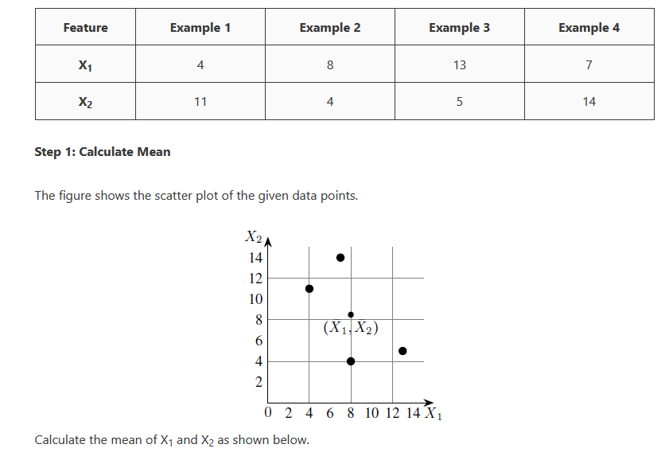
Given the data in Table, reduce the dimension from 2 to 1 using the Principal Component Analysis (PCA) algorithm.

Slide 38
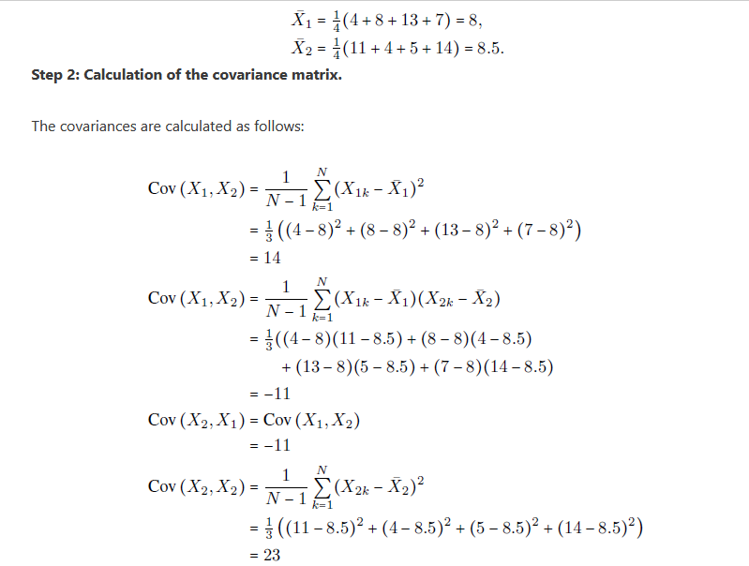

Slide 39
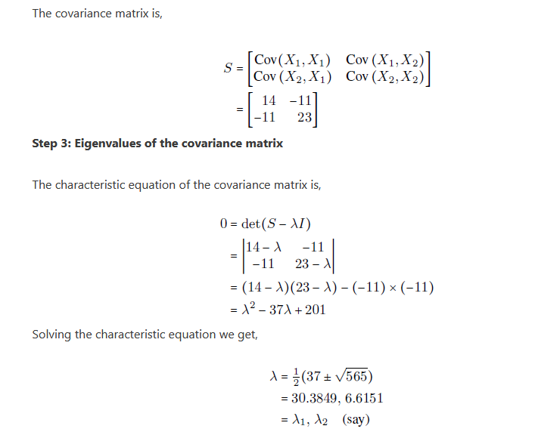

Slide 40
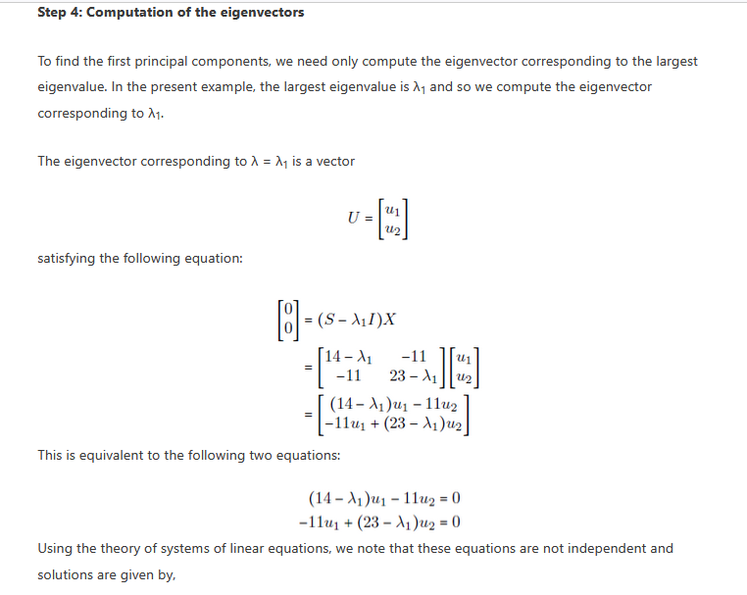

Slide 41
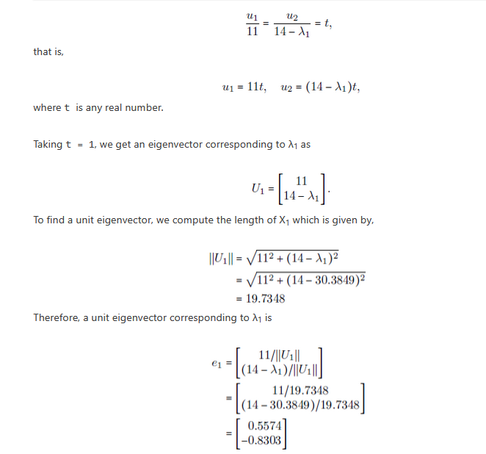

Slide 42
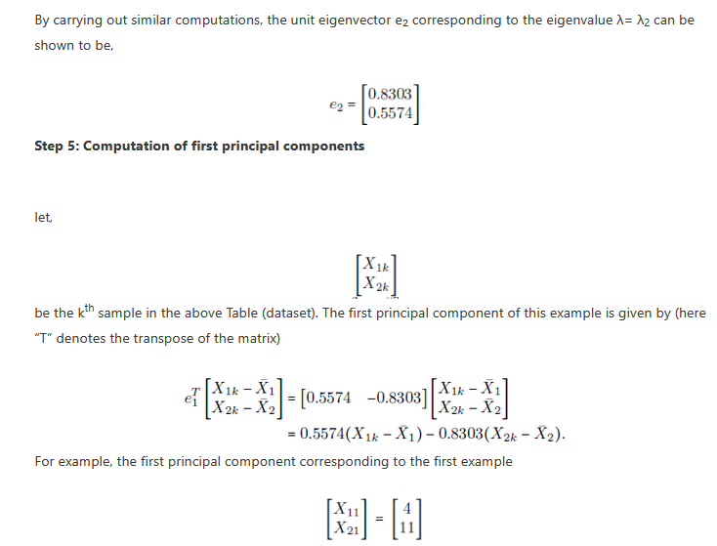

Slide 43
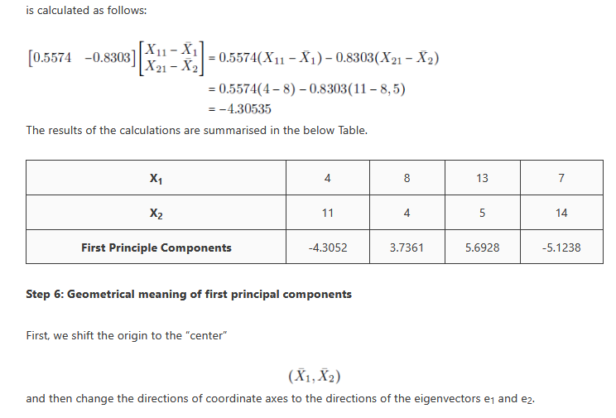

Slide 44
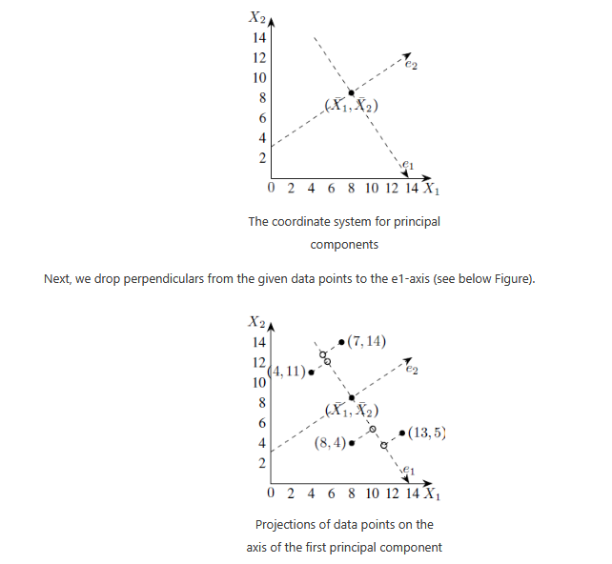

Slide 45
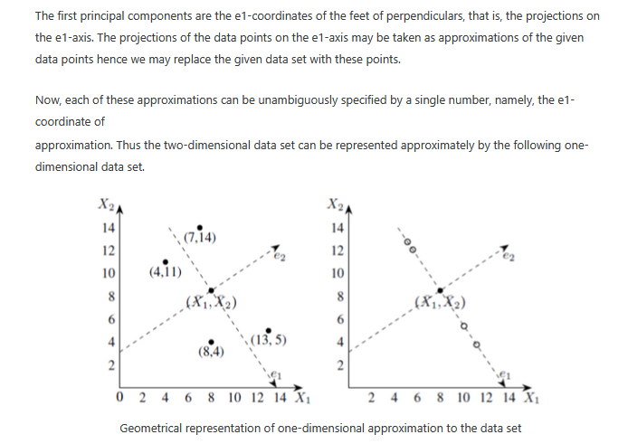

Slide 46
Linear Discriminant Analysis
Linear Discriminant Analysis (LDA) also known as Normal Discriminant Analysis is supervised classification problem that helps separate two or more classes by converting higher-dimensional data space into a lower-dimensional space. It is used to identify a linear combination of features that best separates classes within a dataset.
For example we have two classes that need to be separated efficiently. Each class may have multiple features and using a single feature to classify them may result in overlapping. To solve this LDA is used as it uses multiple features to improve classification accuracy. LDA works by some assumptions and we are required to understand them so that we have a better understanding of its working.

Slide 47
CONTD..
Unlike PCA, which optimizes for variance regardless of class labels, LDA aims to find a linear combination of features that separates different classes. It projects data onto a lower-dimensional space using class labels to accomplish this.
This method is highly efficient in scenarios where the division between categories of data is to be accentuated.

Slide 48
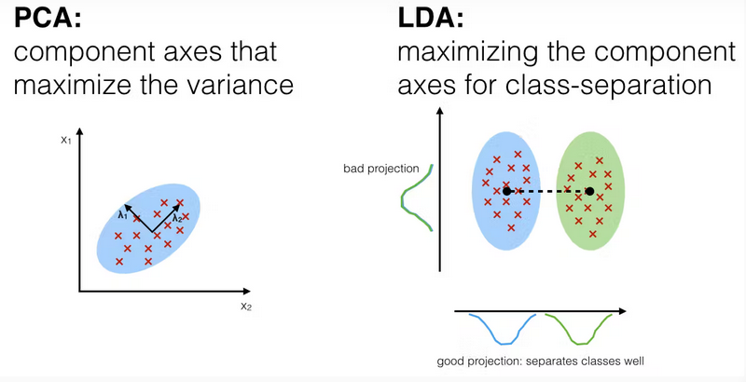

Slide 49
How to Use LDA
Using LDA for dimensionality reduction involves the following steps:
1. Data Preprocessing: Prepare your dataset, ensuring it’s clean, and feature scaling may be required.
2. Compute Class Means and Scatter Matrices: Calculate the mean vectors and scatter matrices for each class in the dataset.
3. Compute Eigenvectors and Eigenvalues: Find the eigenvectors and eigenvalues of the generalized eigenvalue problem formed using the scatter matrices.
4. Sort Eigenvalues: Sort the eigenvalues in descending order and select the top k eigenvectors corresponding to the k largest eigenvalues to form a transformation matrix.
5. Project Data: Project your data onto the new k-dimensional subspace formed by the transformation matrix.

Slide 50

CONTD..
LDA works by finding directions in the feature space that best separate the classes. It does this by maximizing the difference between the class means while minimizing the spread within each class.
Let’s assume we have two classes with d-dimensional samples such as x1,x2,...xn where:
n1​ samples belong to class c1
n2​​ samples belong to class c2.
If xi represents a data point its projection onto the line represented by the unit vector v is
Let the means of class c1​ and class c2 before projection be μ1μ1​​ and μ2μ2​ respectively. After projection the new means are
Our aim to normalize the difference to maximize the class separation. The scatter for samples of class c1​​ is calculated as:

Slide 51
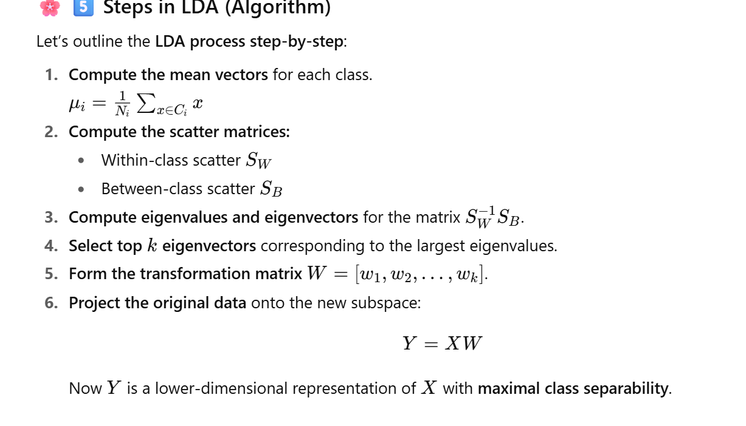

Slide 52
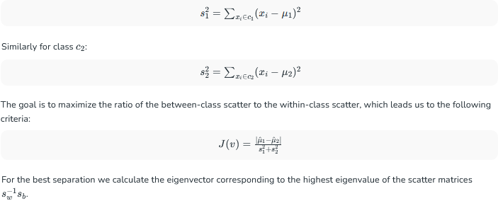
CONTD..

Slide 53
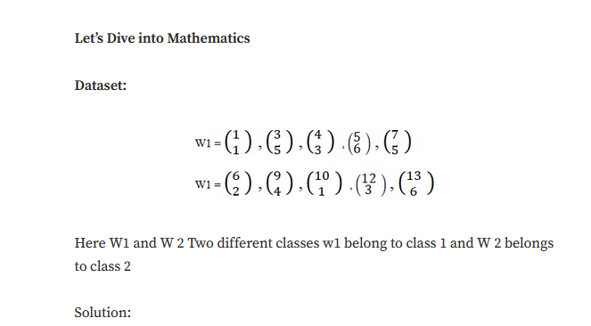

Slide 54
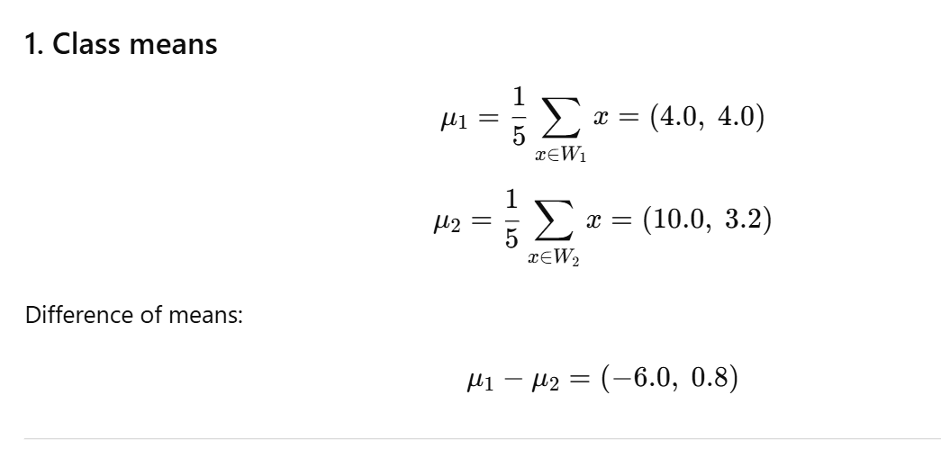

Slide 55
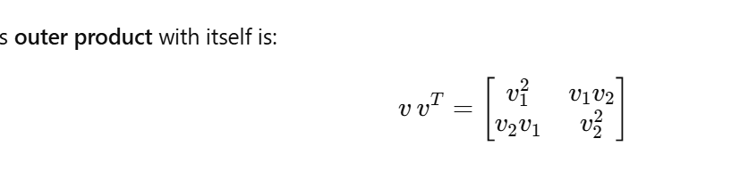

Slide 56
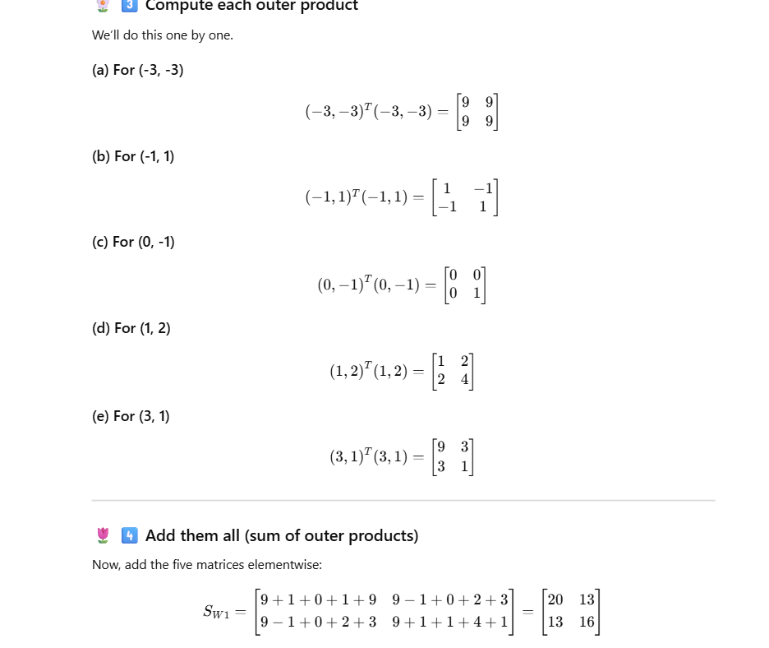

Slide 57
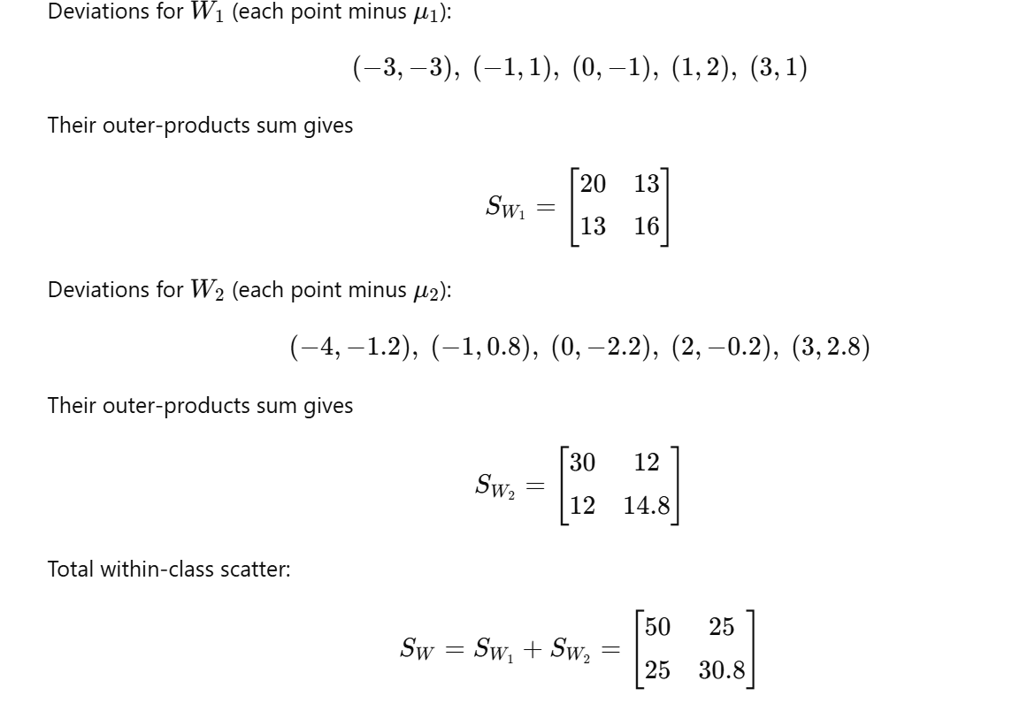

Slide 58
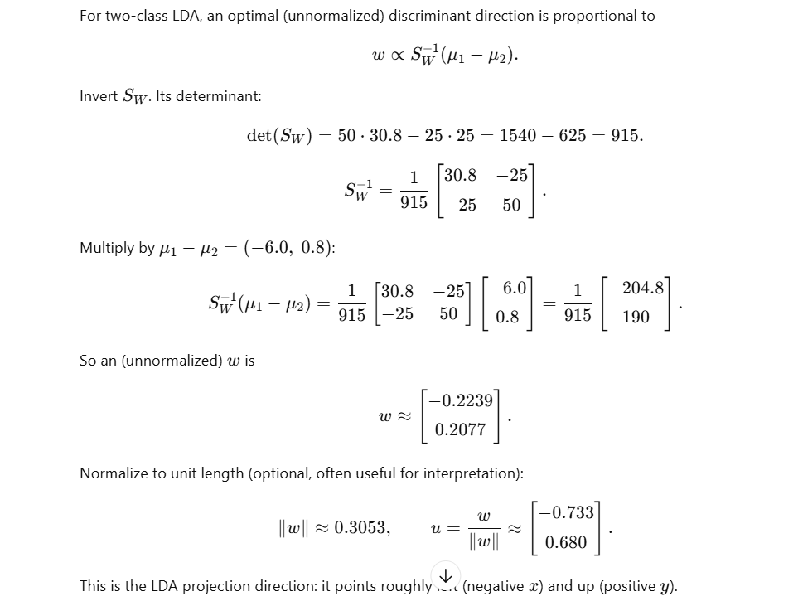

Slide 59
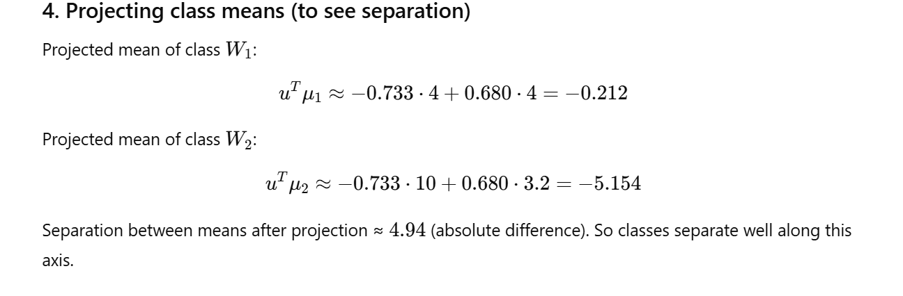

Slide 60
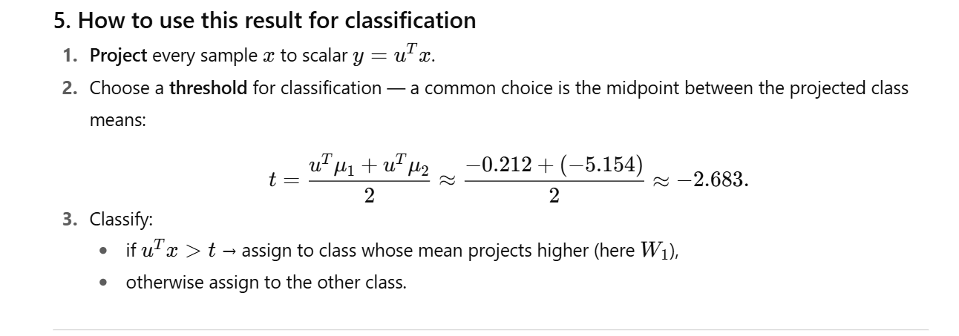

Slide 61
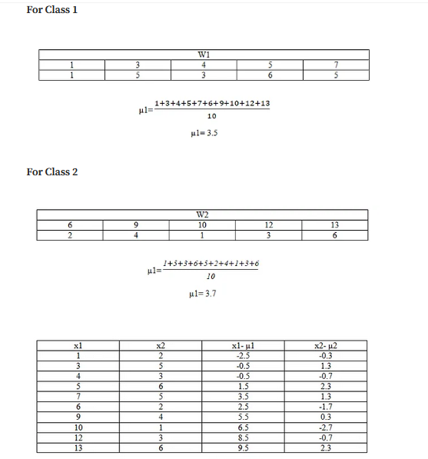

Slide 62
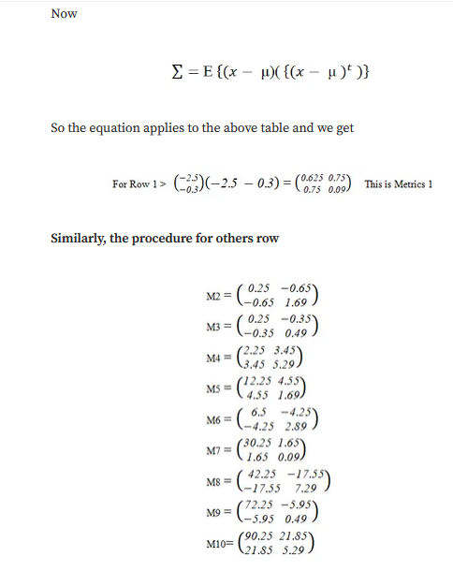

Slide 63
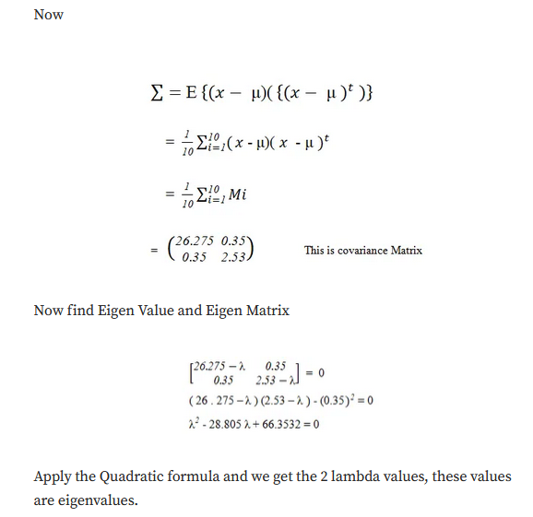

Slide 64
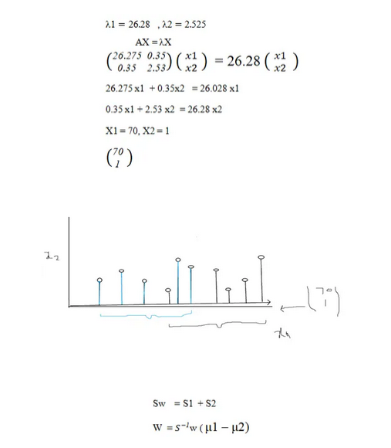

Slide 65
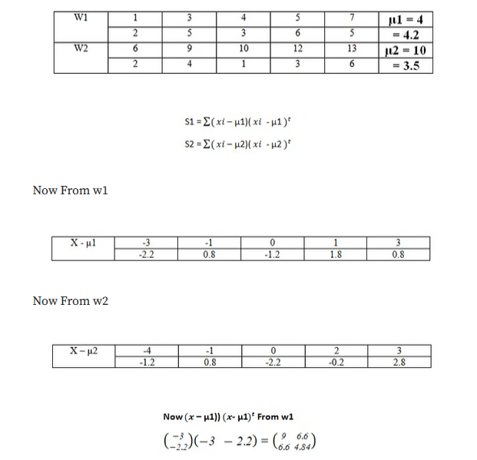

Slide 66
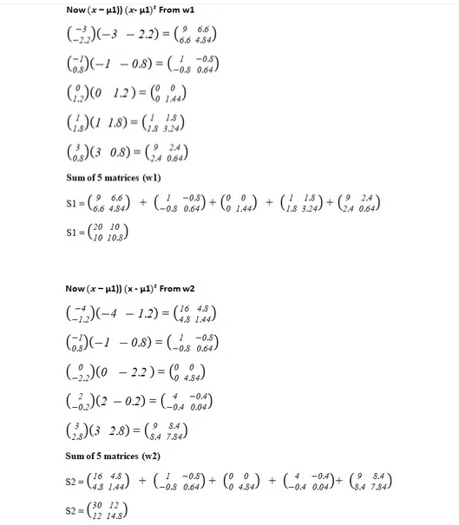

Slide 67
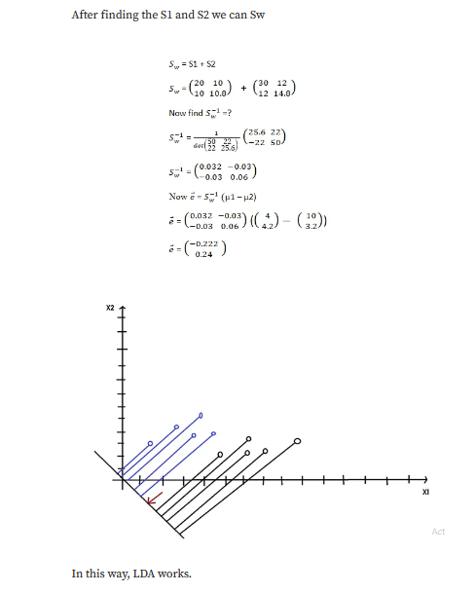

Slide 68
THANK YOU
Team – AI &ML

